Slide 1

Random Variable

Slide 2
Outcomes
1

Slide 3
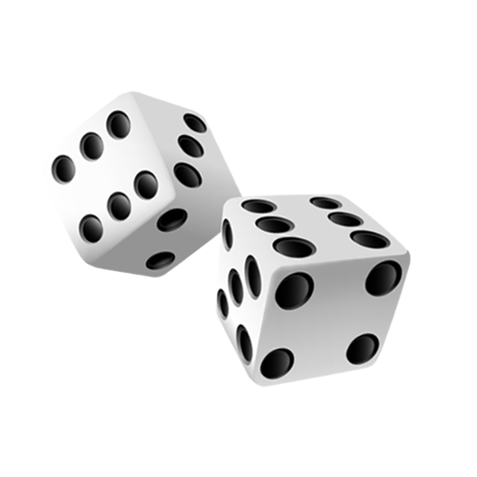
Random Variable
What are the possible outcomes?

Slide 4
Outcomes
All outcomes that could happen is called the set of all possible outcomes, measure space or sample space or Ω.
For a dice roll this would be Ω = {1, 2, 3, 4, 5, 6}
Rock, paper, sci
For a two dice rolls this would be Ω = {(1,1),(1,2),(1,3)... }

Slide 5
Events
2

Slide 6
Events
Suppose we throw a 6, a 3 and a 12. How many events have occured?

Slide 7
Events
An event is the actual occurrence of a possible outcome. We call the set of all events that have occurred the event space or E.

Slide 8
Events
Example
Before we throw a dice, there are 6 hypothetical possibilities:
We throw a 1.
We throw a 2.
We throw a 3.
We throw a 4.
We throw a 5.
We throw a 6.
After we have thrown the dice, one of these possibilities will have actually happened.
If I throw a 6, we observe that the event 6 has occurred. Conceptually, we fill our event set with a 6: E = {6}.

Slide 9
Random Variables
3

Slide 10
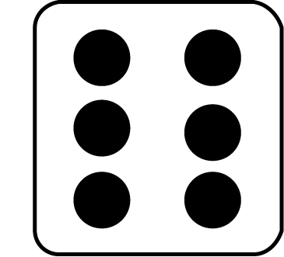
Random Variables
?
Ω = {1, 2, 3, 4, 5, 6}
E = {6}

Slide 11
Random Variables
Random Variable
Ω = {1, 2, 3, 4, 5, 6}
E = {6}

Slide 12
A Random Variable
A random variable is nothing more than a way for us to model the certainty (or uncertainty) for a given event.
It is a function that maps possible outcomes to the actual event. As such, it allows us to model the probability with which an event may happen.
A ‘normal’ variable will always have one value. The value of a random variable, however, depends on some random process (e.g. drawing a card from a card deck, throwing a dice).

Slide 13
A Random Variable
A random variable is nothing more than a way for us to model the certainty (or uncertainty) for a given event.
For instance, the random variable for throwing a dice may sometimes result in (be valued as) a 1, sometimes in a 2, sometimes in a 3… etc.
By extent, the probability of throwing a 6, P(dice throw = 6), is ⅙.
The probability that all events will happen is P(dice throw = 1 or 2 or 3 or 4 or 5 or 6) = 1.

Slide 14
Your turn.
4

Slide 15
Your turn.
I would like you to do an experiment. For this exercise we will pair up again. Pick a coin from your pocket or wallet and throw it 40 times. You will have to record the event for each of these 40 flips. After you’re done, compute how often the coin landed on its head and how often you got tails. On the basis of your experiment, give a description of the random variable (how often there is a mapping to tails and how often to heads).
Tip: One of you could flip, while the other one writes down the results. You can simple use 1/0, for heads and tails.
We will reconvene in 10 minutes and 2 groups will have to present their findings.

Slide 16
Your turn.
Example and format:
Universe: Coin flip.
Possible Outcomes: Ω = {“Heads”, “Tails”}.
Event Space: E = {“Heads”, “Tails”, “Tails”, “Heads”, “Tails”...}
Random Variable: The random variable maps the possible outcomes to the event space.
P(Coin = “Heads”) = ?
P(Coin = “Tails”) = ?

Slide 17
The End.

